Slide 1
MODULE 2
BRUTE FORCE:Background, Selection Sort, Brute-Force String Matching. TSP
(Text Book-1: Chapter 3: 3.1, 3.2)
DIVIDE AND CONQUER: General method, Recurrences: The substitution method, The recursion-tree method, The master method.
(Text Book-2: Chapter 4: 4.4, 4.5),
Merge sort, Quick sort, Binary Search, Multiplication of large integers,
Case study: Strassen’s Matrix Multiplication.
(Text Book-1: Chapter 4: 4.1 to 4.3, 4.5)

Slide 2

Brute Force
A straightforward approach, usually based directly on the problem’s statement and definitions of the concepts involved.
“ A straight forward technique to find the solution for the given problem “
Examples:
Computing an (a > 0, na nonnegative integer)
2. Computing n!
3. Multiplying two matrices
4. Searching for a key of a given value in a list

Slide 3
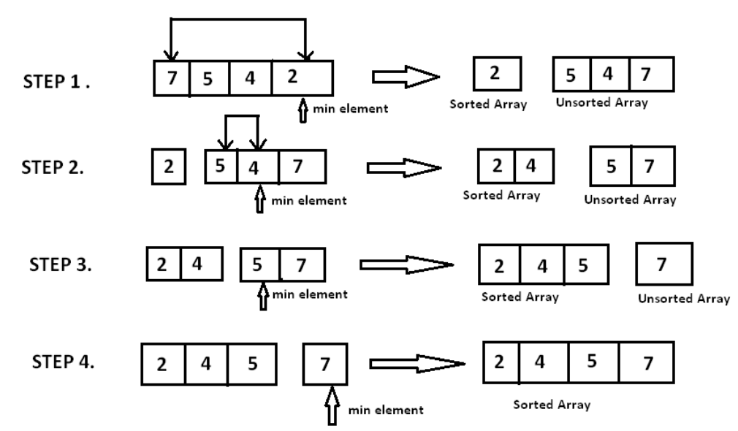
Brute-Force Sorting Algorithm
Selection Sort :
Scan the array to find its smallest element and swap it with the first element.
Then, starting with the second element, scan the elements to the right of it to find the smallest among them and swap it with the second elements.
Generally, on pass i (0 <=i <=n-2), find the smallest element in A[i..n-1] and swap it with A[i]:
A[0] <= . . . <=A[i-1] | A[i], . . . , A[min], . . ., A[n-1] in their final positions.
Example: 7 5 4 2

Slide 4
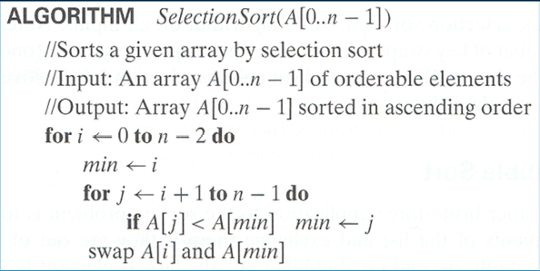
Analysis of Selection Sort
Time efficiency: Θ(n^2)
Space efficiency: Θ(1) , so in place
Stability: YES

Slide 5
Brute-Force String Matching
Pattern: a string of m characters to search for
Text: a (longer) string of n characters to search in
Problem: find a substring in the text that matches the pattern
Brute-force algorithm:
Step 1: Align pattern at beginning of text
Step 2 : Moving from left to right, compare each character of pattern to the corresponding character in text until–all characters are found to match (successful search); or–a mismatch is detected
Step 3: While pattern is not found and the text is not yet exhausted, realign pattern one position to the right and repeat Step 2

Slide 6
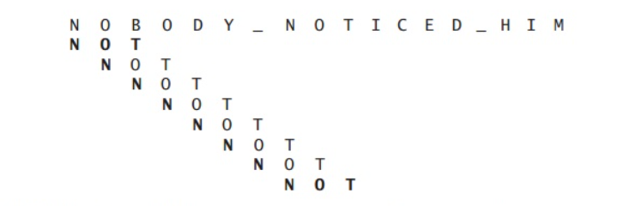
Examples of Brute-Force String Matching
2. Pattern: happy
Text: It is never too late to have a happy childhood.
Pattern: 001011
Text: 10010101101001100101111010

Slide 7
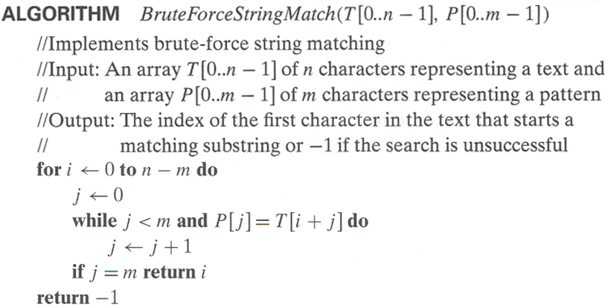
Pseudocode and Efficiency
Time efficiency: Θ(mn)comparisons (in the worst case)
Slides prepared by: Prof. Bharath M B, Assistant Professor, Department of CSE, Dayananda Sagar University, Harohalli, Karnataka

Slide 8
Brute-Force Strengths and Weaknesses
Strengths ::
Wide applicability
Simplicity
Yields reasonable algorithms for some important problems
(e.g., matrix multiplication, sorting, searching, string matching)
Weaknesses ::
Rarely yields efficient algorithms
Some brute-force algorithms are unacceptably slow
Not as constructive as some other design techniques
Slides prepared by: Prof. Bharath M B, Assistant Professor, Department of CSE, Dayananda Sagar University, Harohalli, Karnataka

Slide 9
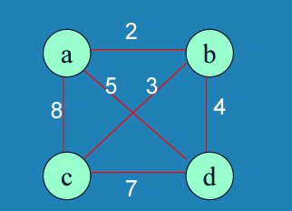
Traveling Salesman Problem
Given N cities with known distances between each pair, find the shortest tour that passes through all the cities exactly once before returning to the starting city
Alternatively: Find shortest Hamiltonian circuit in a weighted connected graph
Example:
TSP by Exhaustive Search::
Tour Cost
a→ b→ c→ d→ a = 2+3+7+5 = 17
a→ b→ d→ c→ a = 2+4+7+8 = 21
a→ c→ b→ d→ a = 8+3+4+5 = 20
a→ c→ d→ b→ a = 8+7+4+2 = 21
a→ d→ b→ c→ a = 5+4+3+8 = 20
a→ d→ c→ b→ a = 5+7+3+2 = 17
Efficiency: Θ((n-1)!)

Slide 10
Analysis of Algorithms
Recurrences
(Chapter 2)

Slide 11
Recurrences and Running Time
An equation or inequality that describes a function in terms of its value on smaller inputs.
T(n) = T(n-1) + n
Recurrences arise when an algorithm contains recursive calls to itself
What is the actual running time of the algorithm?
Need to solve the recurrence
Find an explicit formula of the expression
Bound the recurrence by an expression that involves n

Slide 12
Example Recurrences
T(n) = T(n-1) + n Θ(n²)
Recursive algorithm that loops through the input to eliminate one item
T(n) = T(n/2) + c Θ(lgn)
Recursive algorithm that halves the input in one step
T(n) = T(n/2) + n Θ(n)
Recursive algorithm that halves the input but must examine every item in the input
T(n) = 2T(n/2) + 1 Θ(n)
Recursive algorithm that splits the input into 2 halves and does a constant amount of other work

Slide 13
Recurrent Algorithms BINARY-SEARCH
for an ordered array A, finds if x is in the array A[lo…hi]
Alg.: BINARY-SEARCH (A, lo, hi, x)
if (lo > hi)
return FALSE
mid ← ⎣(lo+hi)/2⎦
if x = A[mid]
return TRUE
if ( x < A[mid] )
BINARY-SEARCH (A, lo, mid-1, x)
if ( x > A[mid] )
BINARY-SEARCH (A, mid+1, hi, x)
1
2
3
4
5
6
7
8
2
3
5
7
9
10
11
12
mid
lo
hi

Slide 14
Example
A[8] = {1, 2, 3, 4, 5, 7, 9, 11}
lo = 1 hi = 8 x = 7
1
2
3
4
5
6
7
8
1
2
3
4
5
7
9
11
mid = 4, lo = 5, hi = 8
5
6
7
8
1
2
3
4
5
7
9
11
mid = 6, A[mid] = x Found!

Slide 15
Another Example
A[8] = {1, 2, 3, 4, 5, 7, 9, 11}
lo = 1 hi = 8 x = 6
1
2
3
4
5
6
7
8
1
2
3
4
5
7
9
11
mid = 4, lo = 5, hi = 8
low
high
1
2
3
4
5
7
9
11
mid = 6, A[6] = 7, lo = 5, hi = 5
low
high
1
2
3
4
5
7
9
11
mid = 5, A[5] = 5, lo = 6, hi = 5
NOT FOUND!
1
2
3
4
5
7
9
11
high
low

Slide 16
Analysis of BINARY-SEARCH
Alg.: BINARY-SEARCH (A, lo, hi, x)
if (lo > hi)
return FALSE
mid ← ⎣(lo+hi)/2⎦
if x = A[mid]
return TRUE
if ( x < A[mid] )
BINARY-SEARCH (A, lo, mid-1, x)
if ( x > A[mid] )
BINARY-SEARCH (A, mid+1, hi, x)
T(n) = c +
T(n) – running time for an array of size n
constant time: c₁
constant time: c₂
constant time: c₃
same problem of size n/2
same problem of size n/2
T(n/2)

Slide 17
Methods for Solving Recurrences
Iteration method
Substitution method
Recursion tree method
Master method

Slide 18
The Iteration Method
Convert the recurrence into a summation and try to bound it using known series
Iterate the recurrence until the initial condition is reached.
Use back-substitution to express the recurrence in terms of n and the initial (boundary) condition.

Slide 19
The Iteration Method
T(n) = c + T(n/2)
T(n) = c + T(n/2)
= c + c + T(n/4)
= c + c + c + T(n/8)
Assume n = 2^{k}
T(n) = c + c + … + c + T(1)
= clgn + T(1)
= Θ(lgn)
T(n/2) = c + T(n/4)
T(n/4) = c + T(n/8)
k times

Slide 20
Iteration Method – Example
T(n) = n + 2T(n/2)
T(n) = n + 2T(n/2)
= n + 2(n/2 + 2T(n/4))
= n + n + 4T(n/4)
= n + n + 4(n/4 + 2T(n/8))
= n + n + n + 8T(n/8)
… = in + 2^{i}T(n/2^{i})
= kn + 2^{k}T(1)
= nlgn + nT(1) = Θ(nlgn)
Assume: n = 2^{k}
T(n/2) = n/2 + 2T(n/4)

Slide 21
The substitution method
Guess a solution
Use induction to prove that the solution works

Slide 22
Substitution method
Guess a solution
T(n) = O(g(n))
Induction goal: apply the definition of the asymptotic notation
T(n) ≤ d g(n), for some d > 0 and n ≥ n₀
Induction hypothesis: T(k) ≤ d g(k) for all k < n
Prove the induction goal
Use the induction hypothesis to find some values of the constants d and n₀ for which the induction goal holds
(strong induction)

Slide 23
Example: Binary Search
T(n) = c + T(n/2)
Guess: T(n) = O(lgn)
Induction goal: T(n) ≤ d lgn, for some d and n ≥ n₀
Induction hypothesis: T(n/2) ≤ d lg(n/2)
Proof of induction goal:
T(n) = T(n/2) + c ≤ d lg(n/2) + c
= d lgn – d + c ≤ d lgn
if: – d + c ≤ 0, d ≥ c
Base case?

Slide 24
Example 2
T(n) = T(n-1) + n
Guess: T(n) = O(n²)
Induction goal: T(n) ≤ c n², for some c and n ≥ n₀
Induction hypothesis: T(n-1) ≤ c(n-1)² for all k < n
Proof of induction goal:
T(n) = T(n-1) + n ≤ c (n-1)² + n
= cn² – (2cn – c - n) ≤ cn²
if: 2cn – c – n ≥ 0 ⇔ c ≥ n/(2n-1) ⇔ c ≥ 1/(2 – 1/n)
For n ≥ 1 ⇒ 2 – 1/n ≥ 1 ⇒ any c ≥ 1 will work

Slide 25
Example 3
T(n) = 2T(n/2) + n
Guess: T(n) = O(nlgn)
Induction goal: T(n) ≤ cn lgn, for some c and n ≥ n₀
Induction hypothesis: T(n/2) ≤ cn/2 lg(n/2)
Proof of induction goal:
T(n) = 2T(n/2) + n ≤ 2c (n/2)lg(n/2) + n
= cn lgn – cn + n ≤ cn lgn
if: - cn + n ≤ 0 ⇒ c ≥ 1
Base case?

Slide 26
Changing variables
T(n) = 2T( ) + lgn
Rename: m = lgn ⇒ n = 2^{m}
T (2^{m}) = 2T(2^{m/2}) + m
Rename: S(m) = T(2^{m})
S(m) = 2S(m/2) + m ⇒ S(m) = O(mlgm) (demonstrated before)
T(n) = T(2^{m}) = S(m) = O(mlgm)=O(lgnlglgn)
Idea: transform the recurrence to one that you have seen before

Slide 27
The recursion-tree method
Convert the recurrence into a tree:
Each node represents the cost incurred at various levels of recursion
Sum up the costs of all levels
Used to “guess” a solution for the recurrence

Slide 28
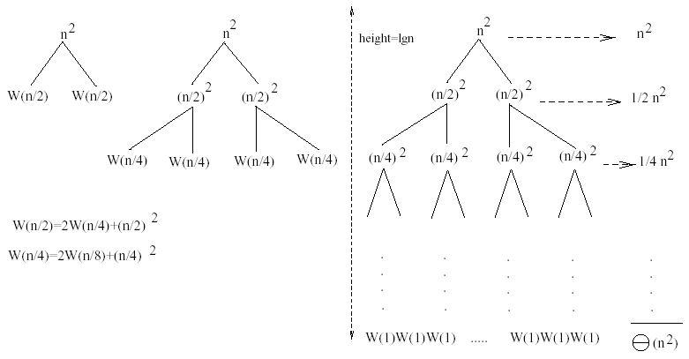
Example 1
W(n) = 2W(n/2) + n²
Subproblem size at level i is: n/2^{i}
Subproblem size hits 1 when 1 = n/2^{i} ⇒ i = lgn
Cost of the problem at level i = (n/2^{i})² No. of nodes at level i = 2^{i}
Total cost:
⇒ W(n) = O(n²)

Slide 29
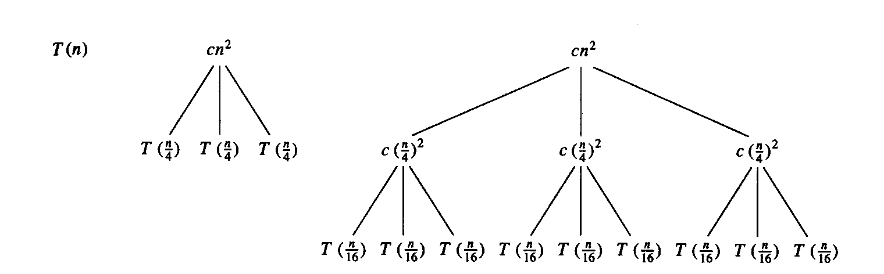
Example 2
E.g.: T(n) = 3T(n/4) + cn²
Subproblem size at level i is: n/4^{i}
Subproblem size hits 1 when 1 = n/4^{i} ⇒ i = log₄n
Cost of a node at level i = c(n/4^{i})²
Number of nodes at level i = 3^{i} ⇒ last level has 3^{log}₄^{n} = n^{log}₄³ nodes
Total cost:
⇒ T(n) = O(n²)

Slide 30
Example 2 - Substitution
T(n) = 3T(n/4) + cn²
Guess: T(n) = O(n²)
Induction goal: T(n) ≤ dn², for some d and n ≥ n₀
Induction hypothesis: T(n/4) ≤ d (n/4)²
Proof of induction goal:
T(n) = 3T(n/4) + cn²
≤ 3d (n/4)² + cn²
= (3/16) d n² + cn²
≤ d n² if: d ≥ (16/13)c
Therefore: T(n) = O(n²)

Slide 31
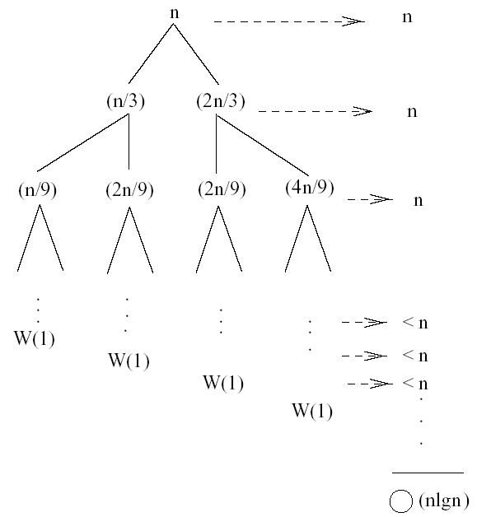
Example 3 (simpler proof)
W(n) = W(n/3) + W(2n/3) + n
The longest path from the root to a leaf is: n → (2/3)n → (2/3)² n → … → 1
Subproblem size hits 1 when 1 = (2/3)^{i}n ⇔ i=log_{3/2}n
Cost of the problem at level i = n
Total cost:
⇒ W(n) = O(nlgn)

Slide 32
Example 3
W(n) = W(n/3) + W(2n/3) + n
The longest path from the root to a leaf is: n → (2/3)n → (2/3)² n → … → 1
Subproblem size hits 1 when 1 = (2/3)^{i}n ⇔ i=log_{3/2}n
Cost of the problem at level i = n
Total cost:
⇒ W(n) = O(nlgn)

Slide 33
Example 3 - Substitution
W(n) = W(n/3) + W(2n/3) + O(n)
Guess: W(n) = O(nlgn)
Induction goal: W(n) ≤ dnlgn, for some d and n ≥ n₀
Induction hypothesis: W(k) ≤ d klgk for any K < n (n/3, 2n/3)
Proof of induction goal:
Try it out as an exercise!!
T(n) = O(nlgn)

Slide 34
Master’s method
“Cookbook” for solving recurrences of the form:
where, a ≥ 1, b > 1, and f(n) > 0
Idea: compare f(n) with n^{log}_{b}ª
f(n) is asymptotically smaller or larger than n^{log}_{b}ª by a polynomial factor n^{ε}
f(n) is asymptotically equal with n^{log}_{b}ª

Slide 35
Master’s method
“Cookbook” for solving recurrences of the form:
where, a ≥ 1, b > 1, and f(n) > 0
Case 1: if f(n) = O(n^{log}_{b}^{a -ε}) for some ε > 0, then: T(n) = Θ(n^{log}_{b}ª)
Case 2: if f(n) = Θ(n^{log}_{b}ª), then: T(n) = Θ(n^{log}_{b}ª lgn)
Case 3: if f(n) = Ω(n^{log}_{b}^{a +ε}) for some ε > 0, and if
af(n/b) ≤ cf(n) for some c < 1 and all sufficiently large n, then:
T(n) = Θ(f(n))
regularity condition

Slide 36
Why n^{log}_{b}ª?
Case 1:
If f(n) is dominated by n^{log}_{b}ª:
T(n) = Θ(n^{log}_{b}^{n})
Case 3:
If f(n) dominates n^{log}_{b}ª:
T(n) = Θ(f(n))
Case 2:
If f(n) = Θ(n^{log}_{b}ª):
T(n) = Θ(n^{log}_{b}ª logn)
Assume n = b^{k} ⇒ k = log_{b}n
At the end of iteration i = k:

Slide 37
Examples
T(n) = 2T(n/2) + n
a = 2, b = 2, log₂2 = 1
Compare n^{log}₂² with f(n) = n
⇒ f(n) = Θ(n) ⇒ Case 2
⇒ T(n) = Θ(nlgn)

Slide 38
Examples
T(n) = 2T(n/2) + n²
a = 2, b = 2, log₂2 = 1
Compare n with f(n) = n²
⇒ f(n) = Ω(n^{1+ε}) Case 3 ⇒ verify regularity cond.
a f(n/b) ≤ c f(n)
⇔ 2 n²/4 ≤ c n² ⇒ c = ½ is a solution (c<1)
⇒ T(n) = Θ(n²)

Slide 39
Examples (cont.)
T(n) = 2T(n/2) +
a = 2, b = 2, log₂2 = 1
Compare n with f(n) = n^{1/2}
⇒ f(n) = O(n^{1-ε}) Case 1
⇒ T(n) = Θ(n)

Slide 40
Examples
T(n) = 3T(n/4) + nlgn
a = 3, b = 4, log₄3 = 0.793
Compare n^{0.793} with f(n) = nlgn
f(n) = Ω(n^{log}₄^{3+ε}) Case 3
Check regularity condition:
3∗(n/4)lg(n/4) ≤ (3/4)nlgn = c ∗f(n), c=3/4
⇒T(n) = Θ(nlgn)

Slide 41
Examples
T(n) = 2T(n/2) + nlgn
a = 2, b = 2, log₂2 = 1
Compare n with f(n) = nlgn
seems like case 3 should apply
f(n) must be polynomially larger by a factor of n^{ε}
In this case it is only larger by a factor of lgn

